Slide 1

Ball Sort Puzzle
Reinforcement Learning
Artificial Intelligence
Master in Informatics and Computing Engineering
Gonçalo Alves – up201806451 Gustavo Mendes – up201806078
Pedro Seixas – up201806227

Slide 2
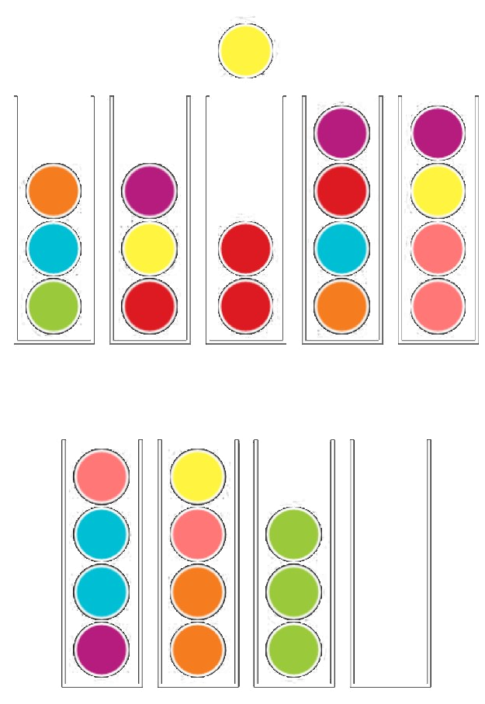

Formulation of the problem as an ML problem
The objective of the Ball Sort Puzzle is to sort the colored balls in the tubes until all balls with the same color stay in the same tube.
The player can only move a ball at the top of a tube to:
- an empty tube;
- another tube that has a ball with the same color on top and has enough space;
The player can also undo his moves if he finds himself without moves.

Slide 3
Formulation of the problem as a RL problem
State Representation:
- Ball: [1..n] (n = the number of colors)
Tube: [Ball, Ball, Ball, Ball] or []
Game: [Tube,Tube,…]
Rewards:
Three ways to assign a reward based on verifications:
Verify if the game is finished (+2) or the tube that received a ball is completed (+1)
Verify if the game is invalid (-5) or finished (+20)
Verify if the game is invalid (-1000), finished (+50) or count the number of consecutive balls with the same colour
Actions:
Move(X,Y): move Ball from Tube X to Tube Y
Algorithms:
Q-Learning
SARSA
Monte Carlo

Slide 4
Related Work
Mainly 2D games:
Retro
Slime Volley Gym
Demon Attack
On OpenAI:
Spaces
Environments
On Policies:
Q-Learning
Jupyter Notebook about Q-Learning
SARSA

Slide 5
Description of the tools
Jupyter Notebook – Allows for interactive computing
OpenAI gym - Allows for modeling of a reinforced learning environment
Algorithms - Since the action and the observation space of the puzzle are both discrete, the policies to be implemented are Q-Learning and SARSA

Slide 6
Implementation work already carried out
Programming language: Python, OpenAI, Jupyter Notebook (with Anaconda)
Development environment: VSCode/IntelliJ
Data Structures:
Lists, for representing the Tubes and the Game
File Structure: The Project’s Repository is available at Github
Implemented Work: Modeled Environment and Agent, Q-Learning Algorithm

Slide 7
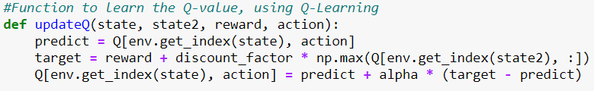
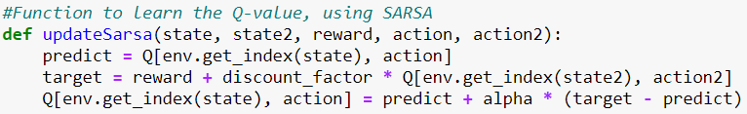
Models
As previously stated, both the Action and the Observation Space are discrete. Therefore, we can apply Q-Learning and SARSA to our RL problem. These algorithms are Model-Free.
Fig 1. Q-Learning Implementation
Fig 2. SARSA Implementation

Slide 8
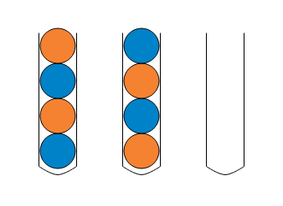
Analysis
Started with a simple configuration, a puzzle with 2 colours and 3 tubes, and used the first evaluation function described: +10, if finished; +1, if a tube was completed using an action; -1, for every other move.
The parameters used were:
Learning rate, 0.5
Discount factor, 0.6
Epsilon, 0.2
Train episodes, 500

Slide 9
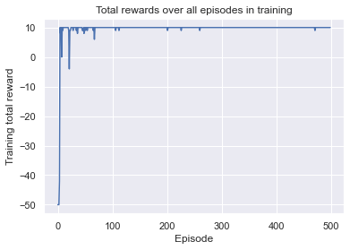
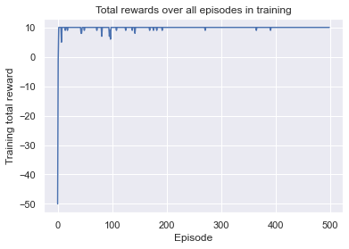
Analysis
Fig 3. Q-Learning with
Training score over time: 9.434
Fig 4. SARSA with
Training score over time: 9.316

Slide 10
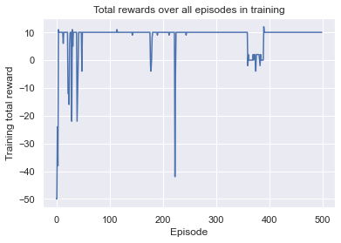
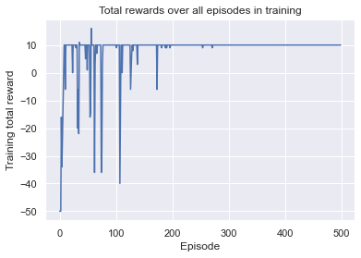
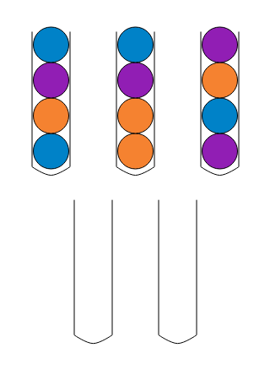
Analysis
After this successful try, a more complex puzzle was tested: 3 colours and 5 tubes. This test was made with the same evaluation function as before.
As we can see and as expected, SARSA is a more conservative algorithm, evident by the absence of “dips” in later episodes. This is because SARSA is on-policy.
Fig 5. Q-Learning with
Training score over time: 8.424
Fig 6. SARSA with
Training score over time: 8.45

Slide 11
Conclusions
Altough a very simplified version of a RL problem, this project allowed us to learn more about the topic of Machine Learning.
As for future work, we would’ve liked to create na abstraction of the puzzle, so that we could “feed” our agent with various configurations of the puzzle and it would be capable of solving them.

